Slide 1

Code Club 9/4/23

Slide 2

Weekly Showcase

Slide 3


What is ?
Multiple people working on code at once
Version history
Code branches
Centralized database
(GitHub) De-facto open-source project storage

Slide 4
Get started!

Slide 5

Try it!
Make a GitHub profile
1
Find the “pr1ncipal” profile
2
Fork the “pr1ncipal/pr1ncipal” repository
3
Or, make your own!
Try messing around with the stuff you can put in your README.md file

Slide 6
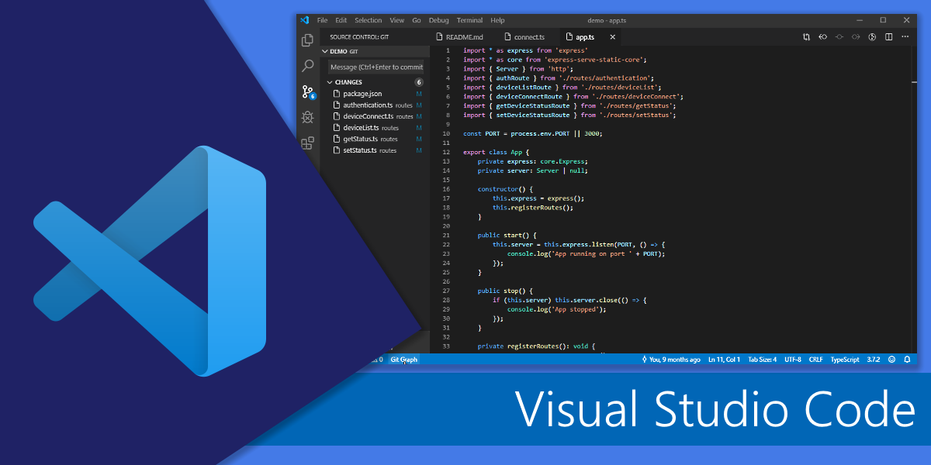
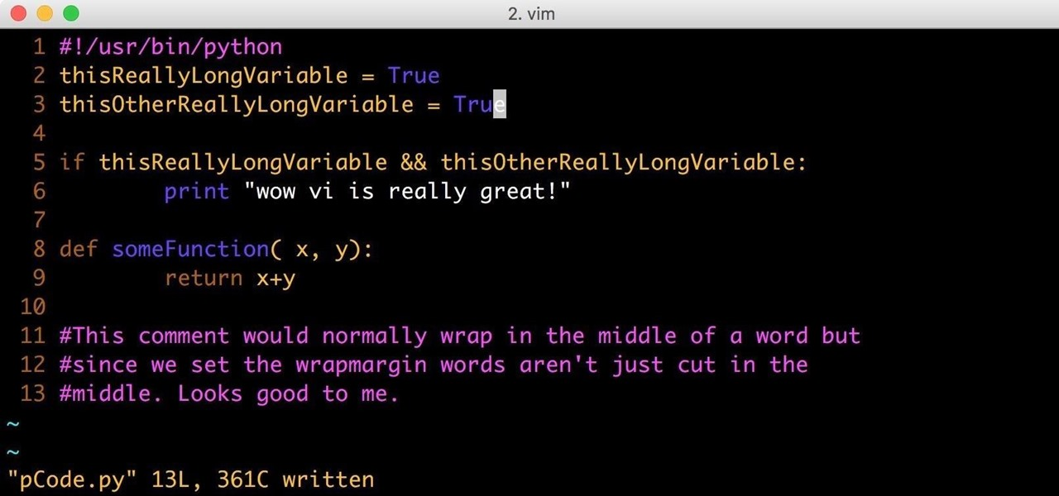
Why use Visual Studio Code?
vim is a simple text editor
Visual Studio Code (VSCode) is a full text editor, but uses extensions as well
VSCode adds functionality to…
Use your mouse
Inline code errors
Show file tree
Multiple files open at once
Directly utilize GitHub
Auto-formatters
Open/edit any type of files, from .txt to python to spreadsheets to images to graphs, etc.

Slide 7


Try it!
Download VSCode
Download python as well, if you don’t have it
Try out some of these extensions:
Python (extension)
Remote SSH
Better Comments
Themes!
If we have time…
Write a “hello world” program in VSCode
Make a new GitHub repository and upload your code!

